Slide 1

JavaScript
Fundamentals
JSON and AJAX

Slide 2
Welcome
Manuel Cubuca
Technical Trainer
Email: manuelc@justit.co.uk

Slide 3
What is JSON
JSON stands for JavaScript Object Notation
THE MOST POPULAR DATA FORMAT ON THE WEB
The JSON syntax is very similar to JavaScript object notation but it is not an object.
JSON format is just plain text often used to send data from a server to a web page
JSON is a format for sending, receiving and storing data
JSON is language independent, code to read and generate JSON data can be written in any programming language

Slide 4
What is JSON cont.
{
"data":[
{
"car":"Mercedes",
"driver":"Lewis",
"wins":2
},
{
"circuit":"Monaco",
"pointsystem":[
{
"firstplace":25,
"secondplace":18,
"thirdplace":15
}
],
"teams":11
}
]
}
Example of a JSON file
You should avoid using functions in JSON, the functions will lose their scope, and you would have to use eval() to convert them back into functions – SEE EXCEPTIONS
The file type for JSON files is ".json"
The MIME type for JSON text is "application/json"

Slide 5
JSON data types
a string
a number
JSON object
an array
a boolean
null
JSON values cannot be one of the following data types:
a function
a date
Undefined
See valid data types and also
Exception for function and date

Slide 6
JSON build-in functions
JSON.parse()
Used to convert any JSON received from the server into JavaScript objects.
JSON.stringify()
Used to convert any JavaScript object into JSON format, and send JSON to the server.

Slide 7
JSONP
JSONP stands for JSON with Padding.
Cross-domain policy can cause issues when requesting data from another domain
Requesting an external script from another domain does not have this issue.
JSONP uses this advantage, and request files using the script tag instead of the XMLHttpRequest object.
<script src="demo_jsonp.php">
For examples and more info click here

Slide 8
Callback Function
When you have no control over the server file, how do you get the server file to call the correct function?
Sometimes the server file offers a callback function as a parameter:
function clickButton() { var s = document.createElement("script"); s.src = "jsonp_demo_db.php?callback=myDisplayFunction"; document.body.appendChild(s); }
For examples and more info click here

Slide 9
JSON resources
JSON Formatter and Validator
JSON Formatter Chrome Add-on
w3schools JSON Introduction
Find JSON files online also GitHub public repositories
https://github.com/dariusk/corpora/tree/master/data
Now let’s practice

Slide 10
What is AJAX
AJAX stands for Asynchronous JavaScript And XML
Ajax is simply a Web Development Technic, used to SEND and RETRIEVE data in the background
Without having to refresh the web page
The data is often sent in a format called JavaScript Object Notation (JSON).

Slide 11
What is AJAX cont.
AJAX stands for Asynchronous JavaScript And XML
AJAX is not a programming language
AJAX uses a browser build-in XMLHttpRequest object (to request data from a server)
AJAX uses an asynchronous processing model, improving and speeding up the user experience

Slide 12
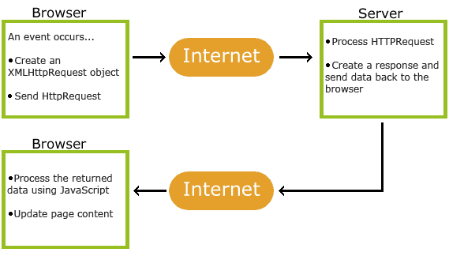
How AJAX Works

Slide 13
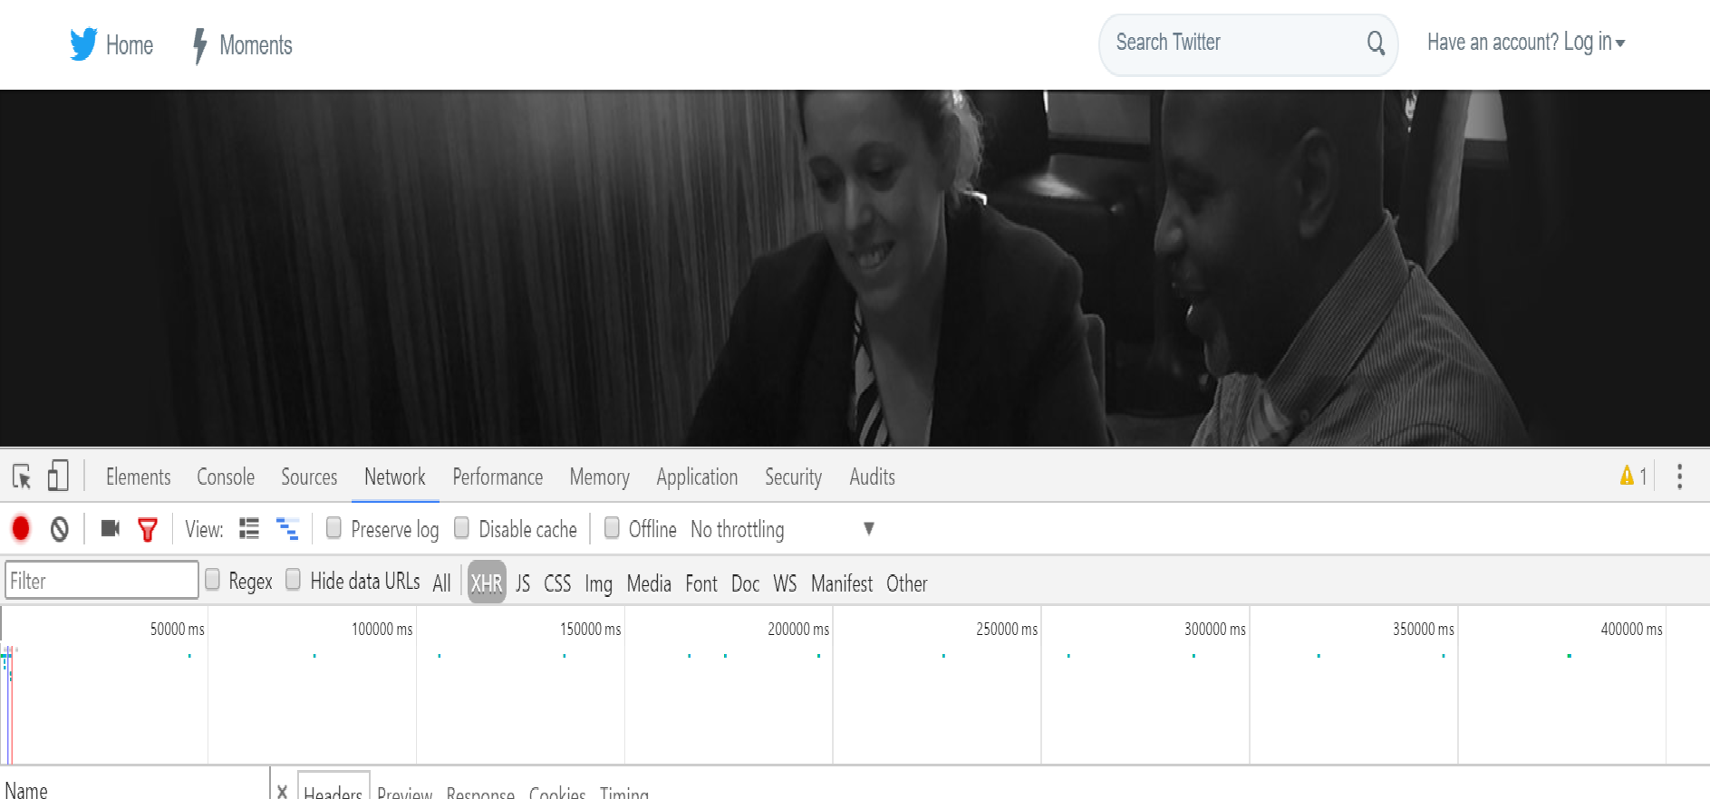
How AJAX Works cont.

Slide 14
The AJAX Request
1
var xhr = new XMLHttpRequest(); // browser build-in object
xhr.open(”GET”, “data/myData.json”, true); // POST (send)
xhr.send();
Creates a new instance of the XMLHttpRequest object and stores the object in a variable
The XMLHttpRequest object’s open() method prepares the request. The 3 parameters are: the HTTP method, the URL of the page and the Boolean to indicate asynchronous
Uses the send() method, is the one that sends the prepared request to the server. Information can be passed to the server in the parentheses, you may also see xhr.open(null)
2
3

Slide 15
The AJAX Response
1
xhr.onload = function() { // could use onreadystatechange
if (this.readyState == 4 && this.status == 200) {
// Code to process the results from the server
}
};
When the browser has received and loaded a response from the server, that will trigger the anonymous function
The function checks the readyState and the status property of the object, to make sure the server’s response was OK, also the data has arrived and available
2

Slide 16
The parse() & stringify() Methods
1
xhr.onload = function() { // could use onreadystatechange
if (this.readyState == 4 && this.status == 200) {
var myData = JSON.parse(this.responseText);
}
};
JSON.parse() processes a string containing JSON data. It converts the JSON data into a JavaScript objects ready for the browser use. JSON.stringify() converts a JavaScript object into a string formatted using JSON, allows to send JavaScript objects from the browser to another application
2
3

Slide 17
AJAX Code Example
function loadMyData() {
var myRequest = new XMLHttpRequest();
myRequest.open("GET", "https://raw.githubusercontent.com/biatoSalo/JSONANDAJAX/master/JSONANDAJAX/expensiveLuxuryCars.json", true);
myRequest.onload = function() {
if (myRequest.readyState == 4 && myRequest.status == 200) {
var myData = JSON.parse(myRequest.responseText);
}
};
myRequest.onerror = function() {
}
myRequest.send();
}

Slide 18
XMLHttpRequest Methods
Method | Description
new XMLHttpRequest() | Creates a new XMLHttpRequest object
abort() | Cancels the current request
getAllResponseHeaders() | Returns header information
getResponseHeader() | Returns specific header information
open(method, url, async, user, psw) | Specifies the request method: the request type GET or POST url: the file location async: true (asynchronous) or false (synchronous) user: optional user name psw: optional password
send() | Sends the request to the server Used for GET requests
send(string) | Sends the request to the server. Used for POST requests
setRequestHeader() | Adds a label/value pair to the header to be sent

Slide 19
XMLHttpRequest Properties
Property | Description
onreadystatechange | Defines a function to be called when the readyState property changes
readyState | Holds the status of the XMLHttpRequest. 0: request not initialized 1: server connection established 2: request received 3: processing request 4: request finished and response is ready
responseText | Returns the response data as a string
responseXML | Returns the response data as XML data
status | Returns the status-number of a request 200: "OK" 403: "Forbidden" 404: "Not Found" For a complete list go to the Http Messages Reference
statusText | Returns the status-text (e.g. "OK" or "Not Found")

Slide 20
AJAX resources
w3schools AJAX introduction
Mozilla Developer Network - AJAX
Use the JSON practice example to practice AJAX
Now hands-on coding

Slide 21
What is an API
API stands for Application Programming Interface
An Interface used by Programs to interact with and Application
stands for API is a set of commands, protocols and tools that allows one piece to software to talk to another, literally is a think for computers to talk together.
There are all kinds of API such as Twitter API, Google API, Weather API, TFL API etc.

Slide 22
REST API
All the API’s above are know as REST API
REST stands for:
REpresentational State Transfer
It works almost the same way a website does
CLIENT
HTTP
SERVER
http://maps.googleapis.com/maps/api/geocode/json?address=london

Slide 23
API’s Directory
Click the button for a list of Web based API’s
API’s are consumed by Programs and not HUMANS
An API is only good if it’s documentation is GREATE, e.g. sample code, live examples and simple to read and understand text.
ProgrammableWeb

Slide 24
Querying an API
API Call:
api.openweathermap.org/data/2.5/weather?q=London,uk
Query the API:
?q=
Multiple queries:
?q=………&……..&……….
End points – This is given to you by the API service

Slide 25
API resources
Use the JSON practice example to practice AJAX
Now hands-on coding

